Slide 1



UNIT 4:
So much to do, so little time
Radio show

Slide 2
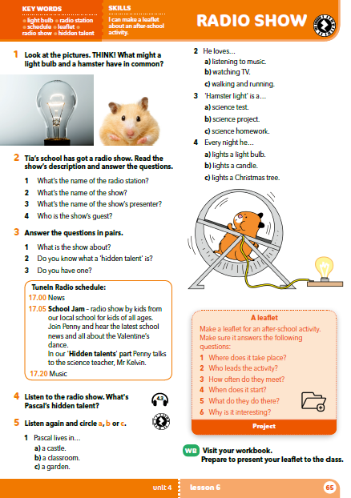
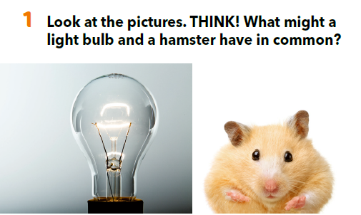

Slide 3
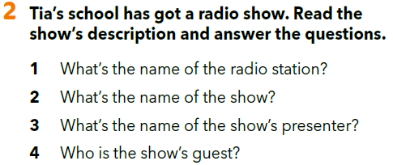
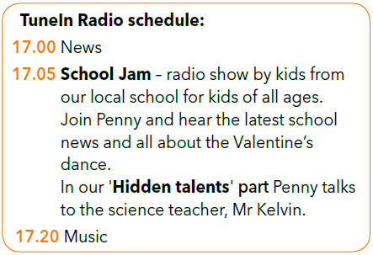
Practise:
https://www.bookwidgets.com/play/t:XTPnHHgf3PM54nxXDxghnDNB4OKyUavIXvZ7m9A9lIZMRUs0Ujk=

Slide 4
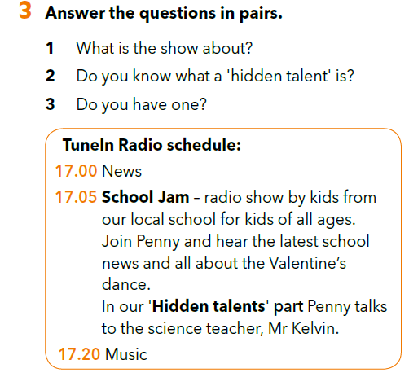
Who is Pascal?
Where does he live?
Does he have a house?
Does he like living there? Why?
What doesn’t he like?

Slide 5
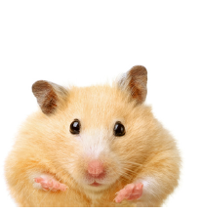

Listen to the recording. What’s Pascal’s hidden talent?
He lights a light bulb when he runs.
https://www.e-sfera.hr/dodatni-digitalni-sadrzaji/bae84367-e901-4215-82ac-560d502801a7/assets/audio/32_unit_4_radio_show.mp3

Slide 6
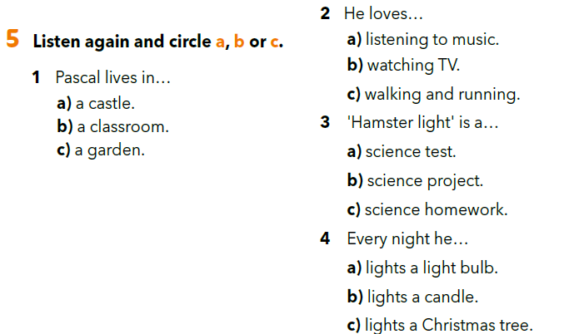
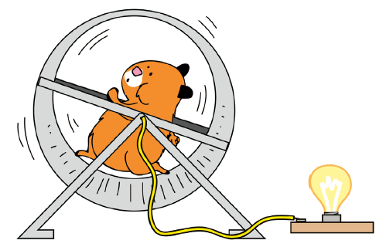
https://www.e-sfera.hr/dodatni-digitalni-sadrzaji/bae84367-e901-4215-82ac-560d502801a7/assets/audio/32_unit_4_radio_show.mp3
Practise:
https://www.bookwidgets.com/play/t:XTPnHHgf3PM54nxXDxghnDNB4OKyUavIXvZ7m9A9lIZMRUs0Ujk=

Slide 7
Look at the texts about Rita, Henry, Dao and Luka on page 56.
Write 3 or 4 sentences about Pascal.
You can begin with: ” I live in a classroom and I love…”

Slide 8
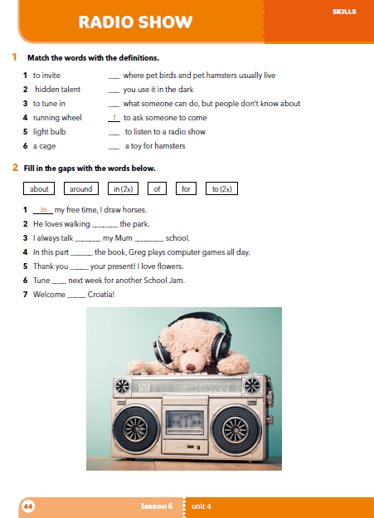
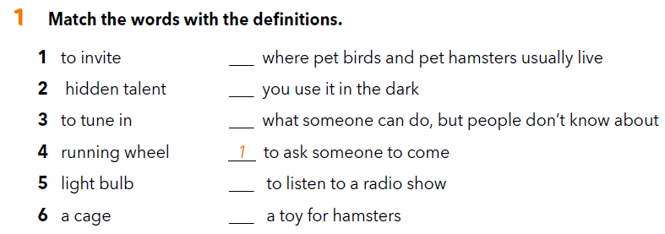
Workbook p 44.
6
5
2
3
4

Slide 9
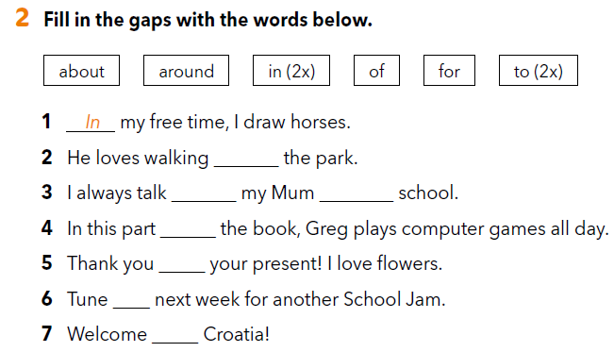
around
to
about
of
for
in
to

Slide 10
What’s the name of the radio station we listened to?
What’s the name of the show?
Who’s the presenter?
Who’s the guest?

Slide 11
What’s Pascal’s hidden talent?
What’s the name of the science project?
Can you remember – What’s the name of the Science Club?

Slide 12
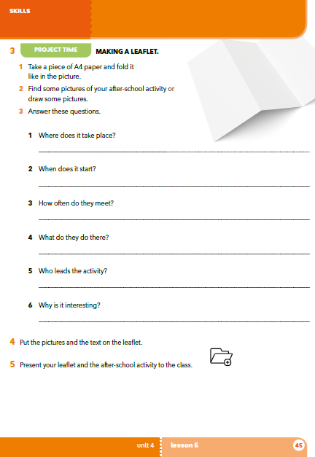

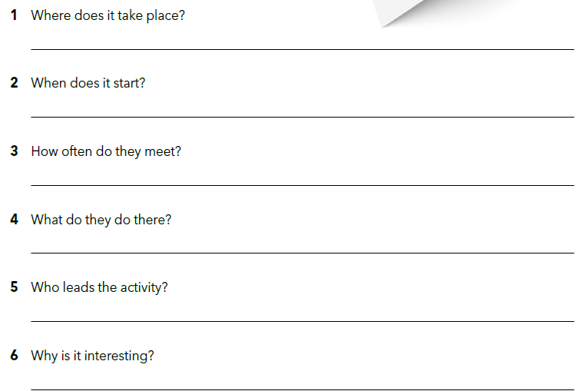
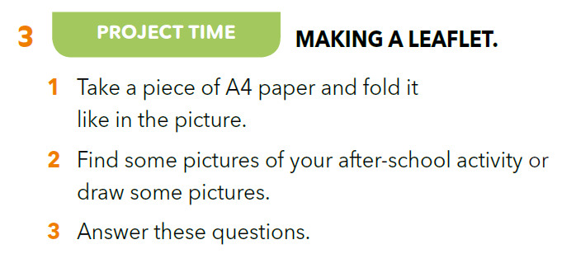
Gdje se odvija aktivnost?
Kada počinje?
Koliko se često održava?
Što radite na toj aktivnosti?
Tko vodi aktivnost?
Zašto je zanimljiva?

Slide 14

Copy the table in your notebook.
Članovi Aktivnost / Slike Prezentacija
Grupe klub
Poslušaj prezentacije letaka ostalih učenika/grupa i vrednuj ih prema kategorijama u tablici.

Slide 15

SELF CHECK
https://www.e-sfera.hr/dodatni-digitalni-sadrzaji/bae84367-e901-4215-82ac-560d502801a7/

Slide 16
LEARN MORE.
https://www.e-sfera.hr/dodatni-digitalni-sadrzaji/bae84367-e901-4215-82ac-560d502801a7/
How much do you know about the radio?

